Slide 1
Chapter 8 NP-complete problems
School of Science, Yanshan University
Wang Gang

Slide 2
Concepts
Decision problem: Say yes-no.
Search problem: Find a feasible solution.
Optimization problem: Find a best solution.
Satisfiability (SAT): Find a satisfying truth assignment to the given CNF.
Horn formula: All clauses contain at most one positive literal.
2SAT: All clauses contain at most 2 literals.
3SAT: All clauses contain at most 3 literals.
E3SAT: All clauses contain exactly 3 literals.
Max SAT: Find an assignment to satisfy the most clauses.
Hamiltonian path problem: Find a path that visits each vertex exactly once.
Eulerian trail problem: Find a trace that visits each edge exactly once.
TSP: Find a shortest Hamiltonian cycle.
MST:

Slide 3
Concepts
Minimum cut problem: Find a vertex cut with the least edges.
Balanced cut problem: The two vertex subsets are of similar size.
Integer linear programming (ILP): All variables are restricted to be integers.
Zero-One Equations (ZOE): Ax = 1.
Bipartite matching problem:
Three-dimensional matching problem(3DM): Find n independent triples out of m triples in a tripartite graph with 3n nodes.
Independent set: A set of vertices, no two of which are adjacent.
Clique: A set of vertices, all of which are adjacent.
Vertex cover: A set of vertices that cover (touch) every edge.
Subset Sum problem: Find a subset of a given set of integers that adds up to a target sum T.

Slide 4
NP-complete problems
Problem and instance
Problem: weight capacity W; weight vector w; values vector v; k items.
Instance: W = 6, w ={2,3,4}, v ={3,4,5}
Coding and instance size n
Binary, n = 18+6",": 110,10,11,100,11,100,101
Unary, n = 27+6",": 111111,11,111,1111,111,1111,11111
80₁₀=1010000₂=1…1₁(eighty 1): , , 80
O(kW) DP algorithm: exponential or polynomial?
P (polynomial time):
Problems that can be solved in time polynomial in n.
NP (nondeterministic polynomial time):
The "yes" instances have proofs verifiable in time polynomial in n.

Slide 5
NP-complete problems
Hard problems, easy problems
Hard Problems (NP-complete) | Easy Problems (P)
3SAT | 2SAT, Horn SAT
TSP | MST
Longest Path | Shortest Path
3DM | Bipartite Matching
Knapsack | Unary Knapsack
Independent Set | Independent Set on Trees
Integer Linear Programming | Linear Programming
Hamiltonian Path | Eulerian Trail
Balanced Cut | Minimum Cut

Slide 6
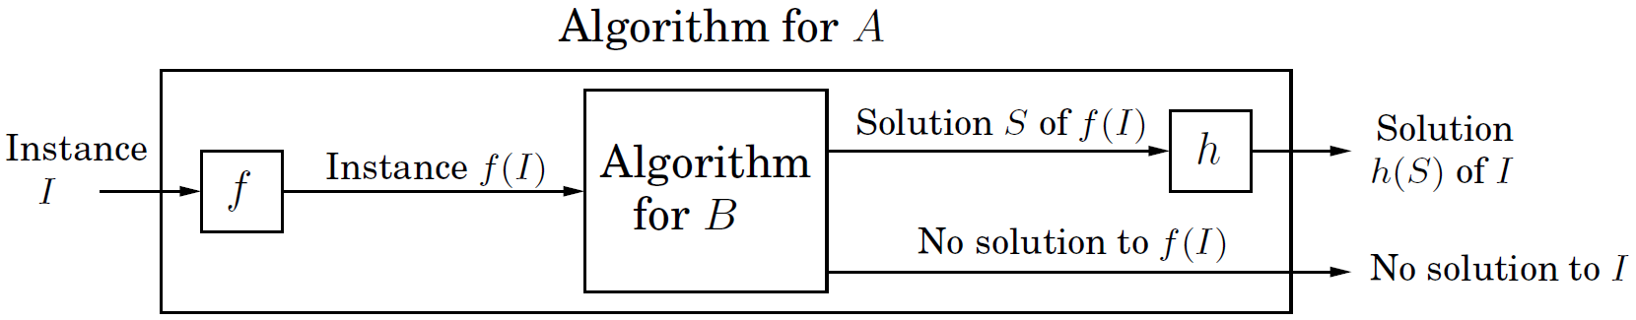
NP-complete problems
Reduction: Translate one problem into another.
NP-hard: All problems in NP can be reduced to it.
NP-complete (NPC): NP ∩ NP-hard.
If PNP,
Factoring
Notes:
观察归约的两个视角

Slide 7
NP-complete problems
The reductions:

Slide 8
SAT → 3SAT
Reduction:
Suppose that the clauses on the right are all satisfied. Then at least one of the literals a₁, …, a_{k} must be true. Otherwise y₁ would have to be true, which would in turn force y₂ to be true, and so on, eventually falsifying the last clause. But this means (a₁∨a₂∨∙∙∙∨a_{k}) is also satisfied.
⇒ If (a₁∨a₂∨∙∙∙∨a_{k}) is satisfied, then some a_{i} must be true. Set y₁, …, y_{i-2} to true and the rest to false. This ensures that the clauses on the right are all satisfied.
If a₄ =1, set y₁= y₂=1, y₃, … = 0, then the formula is satisfied.

Slide 9
NP-complete problems
The reductions:

Slide 10
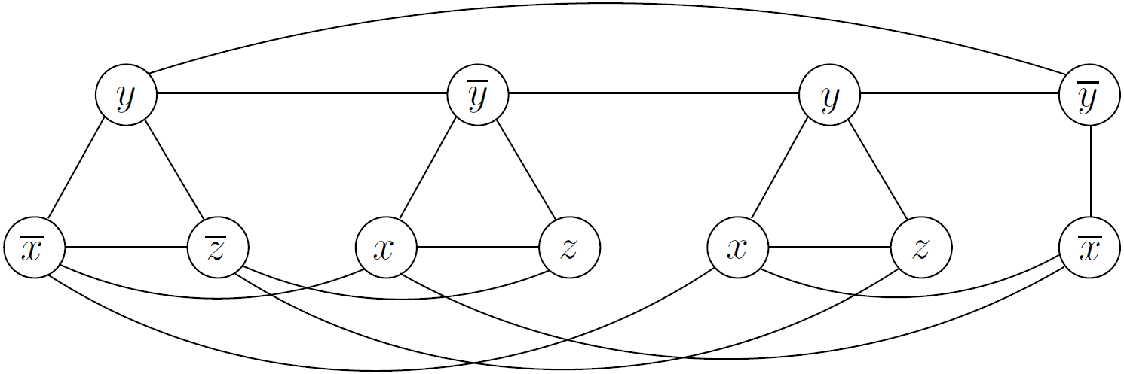
3SAT → Independent Set
3SAT: Find an assignment to a CNF that each clauses contain ≤ 3 literals.
Independent set: Given a graph G, find g pairwise non-adjacent vertices.
Reduction: Represent a clause with 3 literals by a triangle, a clause with 2 literals by a link, with vertices labeled literals in the clause. Put an edge between any two vertices that correspond to opposite literals. g is set to the number of clauses.
Choose a vertex that correspond to a truth literal from each triangle and link, then we can get an independent set, and vice versa.

Slide 11
NP-complete problems
The reductions:

Slide 12
Independent Set → Vertex Cover, and → Clique
Independent Set → Vertex:
S is an independent set ⇔ V−S is a vertex cover.
S={a, c, f, g}
Proof. ⇒ Since S is an independent set of G=(V, E), each edge in E either has its two endpoints in V−S, or crosses the vertex cut (S, V−S). That is to say, V−S touches all the edges. So V−S is a vertex cover.
If S is not an independent set, then it contains some edge, which can not be covered by V−S.
Independent Set → Clique:
S is an independent set in a graph G ⇔ S is a clique in the complementary graph .

Slide 13
NP-complete problems
The reductions:

Slide 14
3SAT → Constrained 3SAT
Constrained 3SAT:
No variable appears in more than 3 clauses;
No literals appears in more than 2 clauses.
Reduction:
Suppose that in the 3SAT instance, variable x appears in k > 3 clauses. Then replace its first appearance by x₁, its second appearance by x₂, and so on. Positive literals are still positive literals, and negative literals are still negative literals. Finally, add the clauses

Slide 15
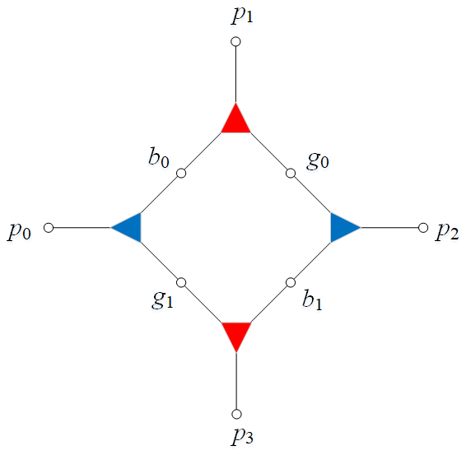
Constrained 3SAT → 3DM
n variables, m clauses.
Reduction:
For each variable x, introduce a dual states gadget, which is a set of four triples, each represented by a triangular node joining a boy, girl, and pet. (2 boys, 2 girls, 4 pets)
(1) If x = 1, choose the two red triples.
The pets p_{x0}, p_{x2} are left.
(2) If x = 0, choose the two blue triples.
The pets p_{x1}, p_{x3} are left.

Slide 16
Constrained 3SAT → 3DM
For each clause, say , introduce a new boy b_{c} and a new girl g_{c}. And introduce three new triples to include them, one for each literal in the clause. And the pets in these triples must reflect the three ways whereby the clause can be satisfied:
(1) positive literal x: (b_{c}, g_{c}, p_{x0}) or (b_{c}, g_{c}, p_{x2}), compatible with x = 1.
If is satisfied by the positive literal x, then x = 1. In the gadget for the variable x, the two red triples (b_{x0}, g_{x0}, p_{x1}) and (b_{x1}, g_{x1}, p_{x3}) are chosen. So the clause children b_{c} and g_{c} can be matched with p_{x0} or p_{x2}.
In constrained 3SAT, no literal appears more than twice, and so each variable gadget has enough pets, two for positive occurrences and two for negative.
(2) negative literal : (b_{c}, g_{c}, p_{y1}) or (b_{c}, g_{c}, p_{y3}), compatible with y = 0.
(3) positive literal z: (b_{c}, g_{c}, p_{z0}) or (b_{c}, g_{c}, p_{z2}), compatible with z = 1.

Slide 17
Constrained 3SAT → 3DM
Garbage collection.
Now m pets are matched by the m clauses. There are still 2n−m pets left unmatched in the variable gadgets. Add 2n−m new boy-girl couples that are generic animal lovers, and match them by 4n(2n−m) triples with all the 4n pets!
Each clause contains ≥ 2 literals. Thus the number of literals l ≥ 2m. Each variable appears ≤ 3 times. So 3n ≥ l ≥ 2m ⇒ n ≥ 2m/3 ⇒ 2n−m > 0.
number of boys = number of girls = number of pets = 4n;
4n gadget triples;
l (≤ 3m) triples for the clauses;
4n(2n−m) triples to collect garbage.
The 3SAT instance is satisfiable ⇔ the 3DM instance has a matching of size 4n.

Slide 18
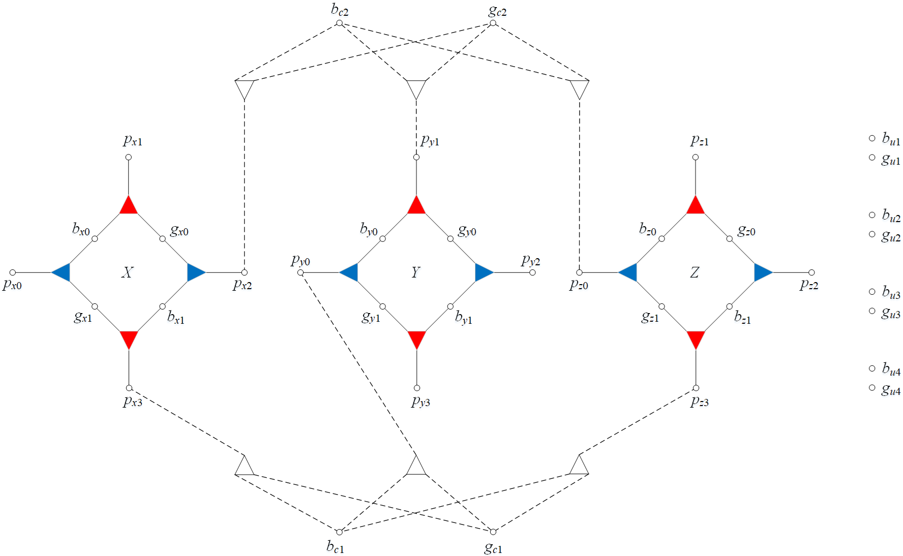
Constrained 3SAT → 3DM
. The garbage triples are not drawn.

Slide 19
NP-complete problems
The reductions

Slide 20
3DM → ZOE
3DM: m boys, m girls, m pets, and n boy-girl-pet triples.
ZOE: Given an mn matrix A with 0-1 entries, and we must find a 0-1 vector x = (x₁, …, x_{n}) such that the m equations Ax = 1 are satisfied.
Reduction:
Introduce 0-1 variables x₁, …, x_{n}, one per triple, where x_{i} = 1 means that the ith triple is chosen for the matching, and x_{i} = 0 means not.
For each boy (girl, pet), suppose that the triples containing him are those numbered j₁,…, j_{k}, introduce the equation x_{j1}+x_{j2}+∙∙∙+x_{jk}=1, which states that exactly one of these triples must be included in the matching.
A is a 3mn matrix. Each row corresponds to a vertex, while each column corresponds to a triple.

Slide 21
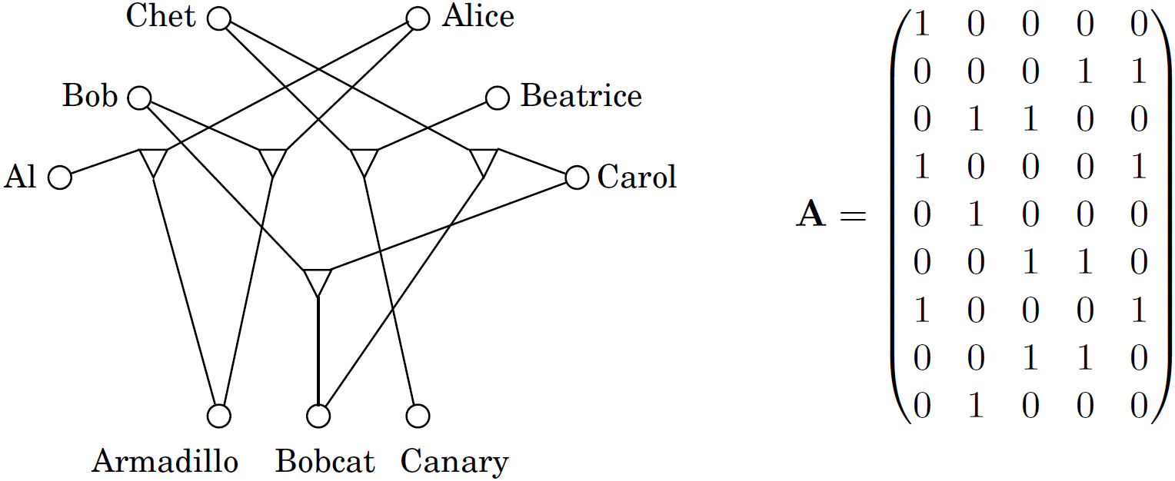
3DM → ZOE
3DM: m boys, m girls, m pets, and n boy-girl-pet triples.
ZOE: Given an mn matrix A with 0-1 entries, and we must find a 0-1 vector x = (x₁, …, x_{n}) such that the m equations Ax = 1 are satisfied.
Reduction:

Slide 22
NP-complete problems
The reductions

Slide 23
ZOE → Subset Sum
ZOE: Given a mn matrix A with 0-1 entries, find a n-dimensional column vector x = (x₁, …, x_{n}) to satisfy Ax = 1.
Subset Sum: Find a subset of a given set of integers that adds up to a target sum T. (1 equation, arbitrary integer coefficients)
Reduction: This is between two special cases of ILP. View x as a column selection vector for the matrix A, and view each column of A as a binary number. This gives a subset sum problem.

Slide 24
NP-complete problems
The reductions

Slide 25
ZOE → ILP
From special cases to general situations: A very useful and common way of establishing NP-hardness.
3SAT → SAT
Vertex Cover → Set Cover
ZOE → ILP
Reduction:
For each variable x_{i}, add the inequalities x_{i} ≥ 0, x_{i} ≤ 1.

Slide 26
NP-complete problems
The reductions

Slide 27
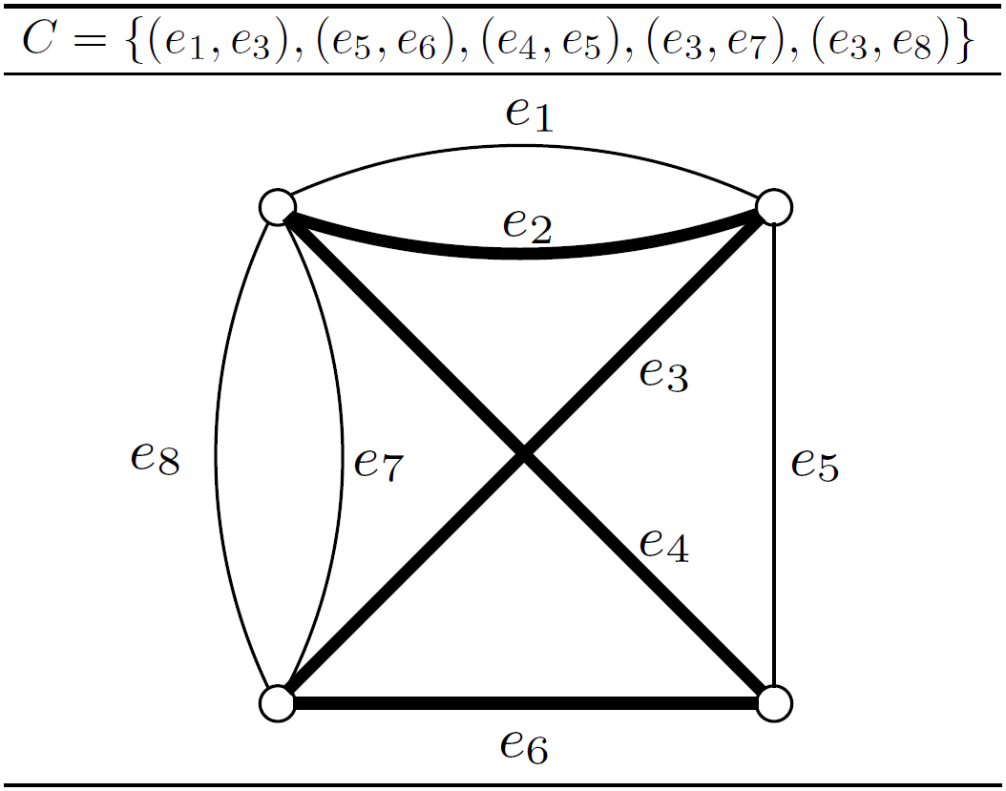
ZOE → Hamiltonian Cycle
Hamiltonian Cycle with Paired Edges: Given a graph G = (V, E) and a set C ⊆ EE of pairs of edges. We seek a cycle that
(1) visits all vertices once, like a Hamiltonian cycle should, and
(2) for every pair of edges (e, e') in C, traverses exactly one of them.
ZOE → Hamiltonian Cycle with Paired Edges → Hamiltonian Cycle

Slide 28
ZOE → Hamiltonian Cycle
ZOE: Given a mn matrix A with 0-1 entries, find a vector x = (x₁, …, x_{n}) to satisfy Ax = 1.
Reduction 1: For each equation, and for each variable x_{i} appearing in it, add to C the pair (e, e') where e is the edge corresponding to the appearance of x_{i} in that equation, and e' is the edge corresponding to the assignment x_{i}=0.

Slide 29
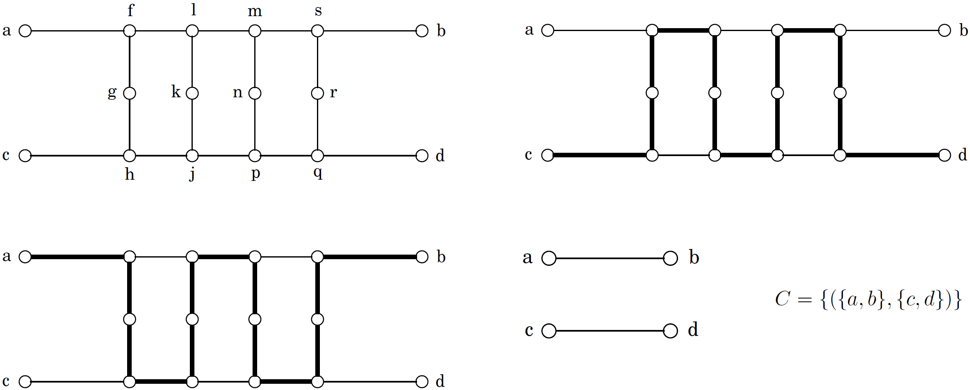
ZOE → Hamiltonian Cycle
Reduction 2:
Figure 8.12 A gadget for enforcing paired behavior.
C={({a,b},{c,d}),({a,b},{u,v})}?
Notes:
C={({a,b},{c,d}),({a,b},{u,v})}?
第二对边的处理：第一对边({a,b},{c,d})处理完之后，从属于{a,b}而不属于{c,d}的边中任选一条，与{u,v}视为一对，然后常规处理即可。

Slide 30
NP-complete problems
The reductions

Slide 31
Hamiltonian Cycle → TSP
Reduction:
Given a graph G = (V, E), construct a TSP instance G'=(V, E', l).
(1) E' contains all the possible n(n−1)/2 edges;
(2) ∀u, v∈V, if (u, v)∈E, then l_{uv}=1; else l_{uv}=1+α; (α is an integer > 0)
(3) The budget = n.
G has a Hamiltonian cycle ⇒ the same cycle in G' is a tour of length n.
Otherwise ⇒ all Hamiltonian cycles in G' have length ≥ n + α.
If α = 1, then all distances are either 1 or 2. So this TSP instance satisfies the triangle inequality. It can be efficiently approximated.
If α > 1, then the triangle inequality may be not satisfied. Either there is a solution of cost n, or all solutions have cost ≥ n + α. This gap property implies that, unless P = NP, no algorithm has approximation ratio better than 1+ α /n → ∞.

Slide 32
NP-complete problems
The reductions

Slide 33

All of NP → SAT (Cook theorem)
斯蒂芬 A. 库克：
1939年生于纽约
1966年哈佛数学博士
长期执教于加拿大多伦多大学
1971年发现NP完全性，1982年获图灵奖

Slide 34
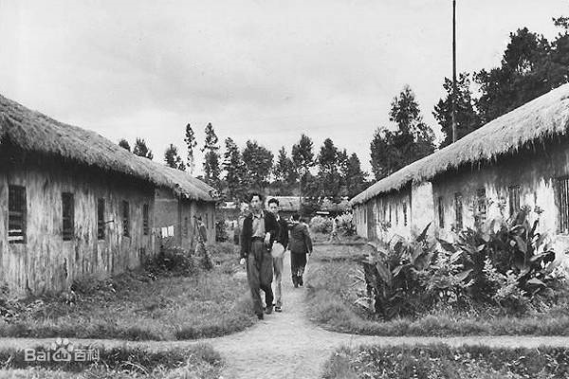
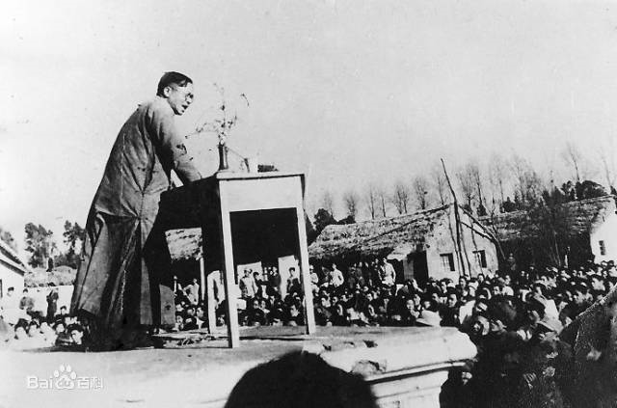
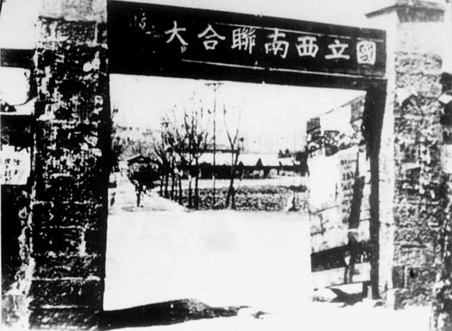
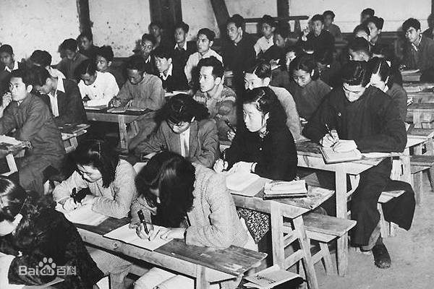
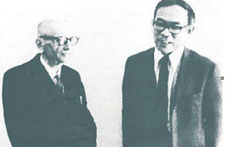
All of NP → SAT (Cook theorem)
王浩 (1921-1995)：济南人，数理逻辑学家。
1939年，西南联大哲学心理学系
1943年，清华哲学部
1946年，哈佛
在昆明受教于金岳霖、沈有鼎、
王宪钧，在哈佛一年完成博士论文。
数学定理机器证明的先驱者。
利用IBM704计算机，仅用3分钟就
证明了罗素《数学原理》中220条
命题。
哥德尔好友，著有《哥德尔》、
《逻辑之旅：从歌德尔到哲学》。

Slide 35
哥德尔成功的事实还提醒我们，一个人天赋再高，想获得一点真重要真耐久的成绩，必须对外界诱惑保持清醒的头脑，永不懈怠地埋头苦干。
——《哥德尔》序言

Slide 36
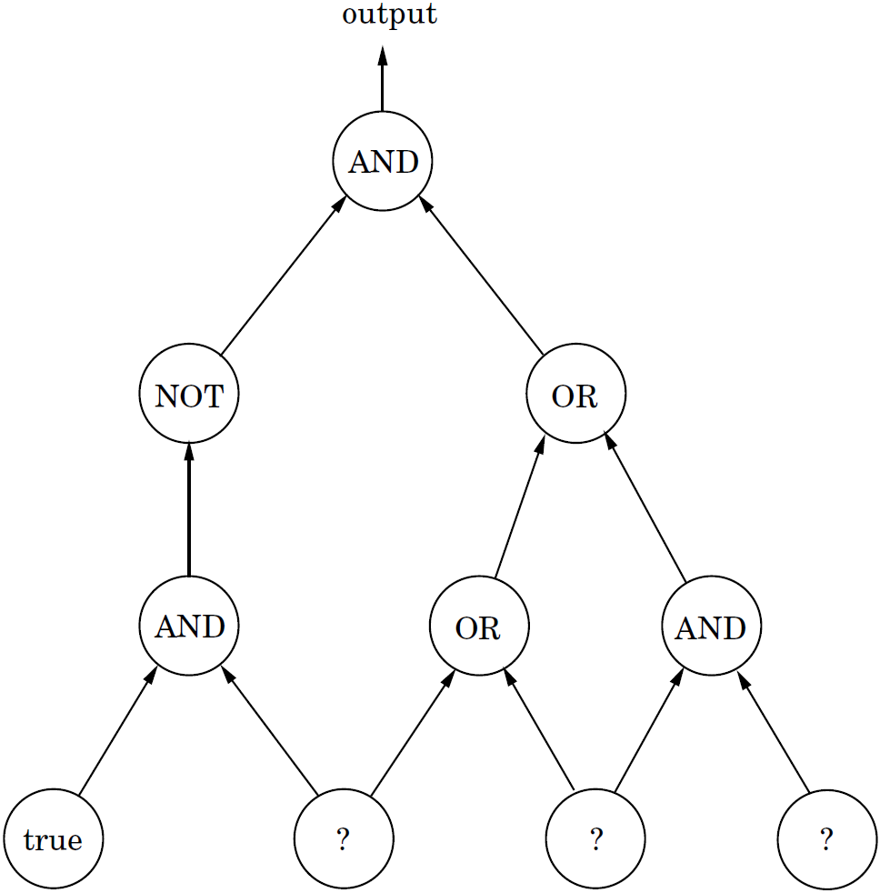
All of NP → SAT (Cook theorem)
Circuit Sat: Given a circuit, find a truth assignment for the unknown inputs such that the output gate evaluates to 1, or report that no such assignment exists.

Slide 37
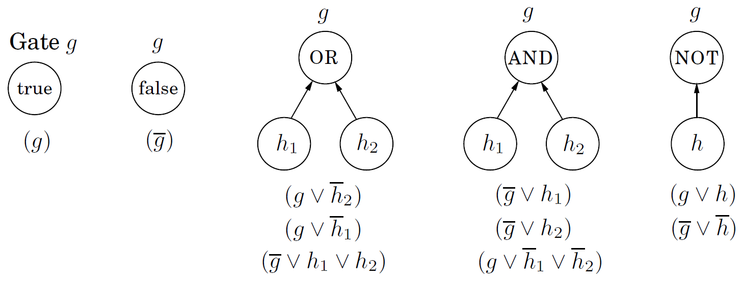
All of NP → Circuit SAT → SAT
Reduction:
For each gate g in the circuit we create a variable g, and we model the effect of the gate using a few clauses:
To finish up, force the output gate g₀ to be true by adding the clause (g₀).

Slide 38
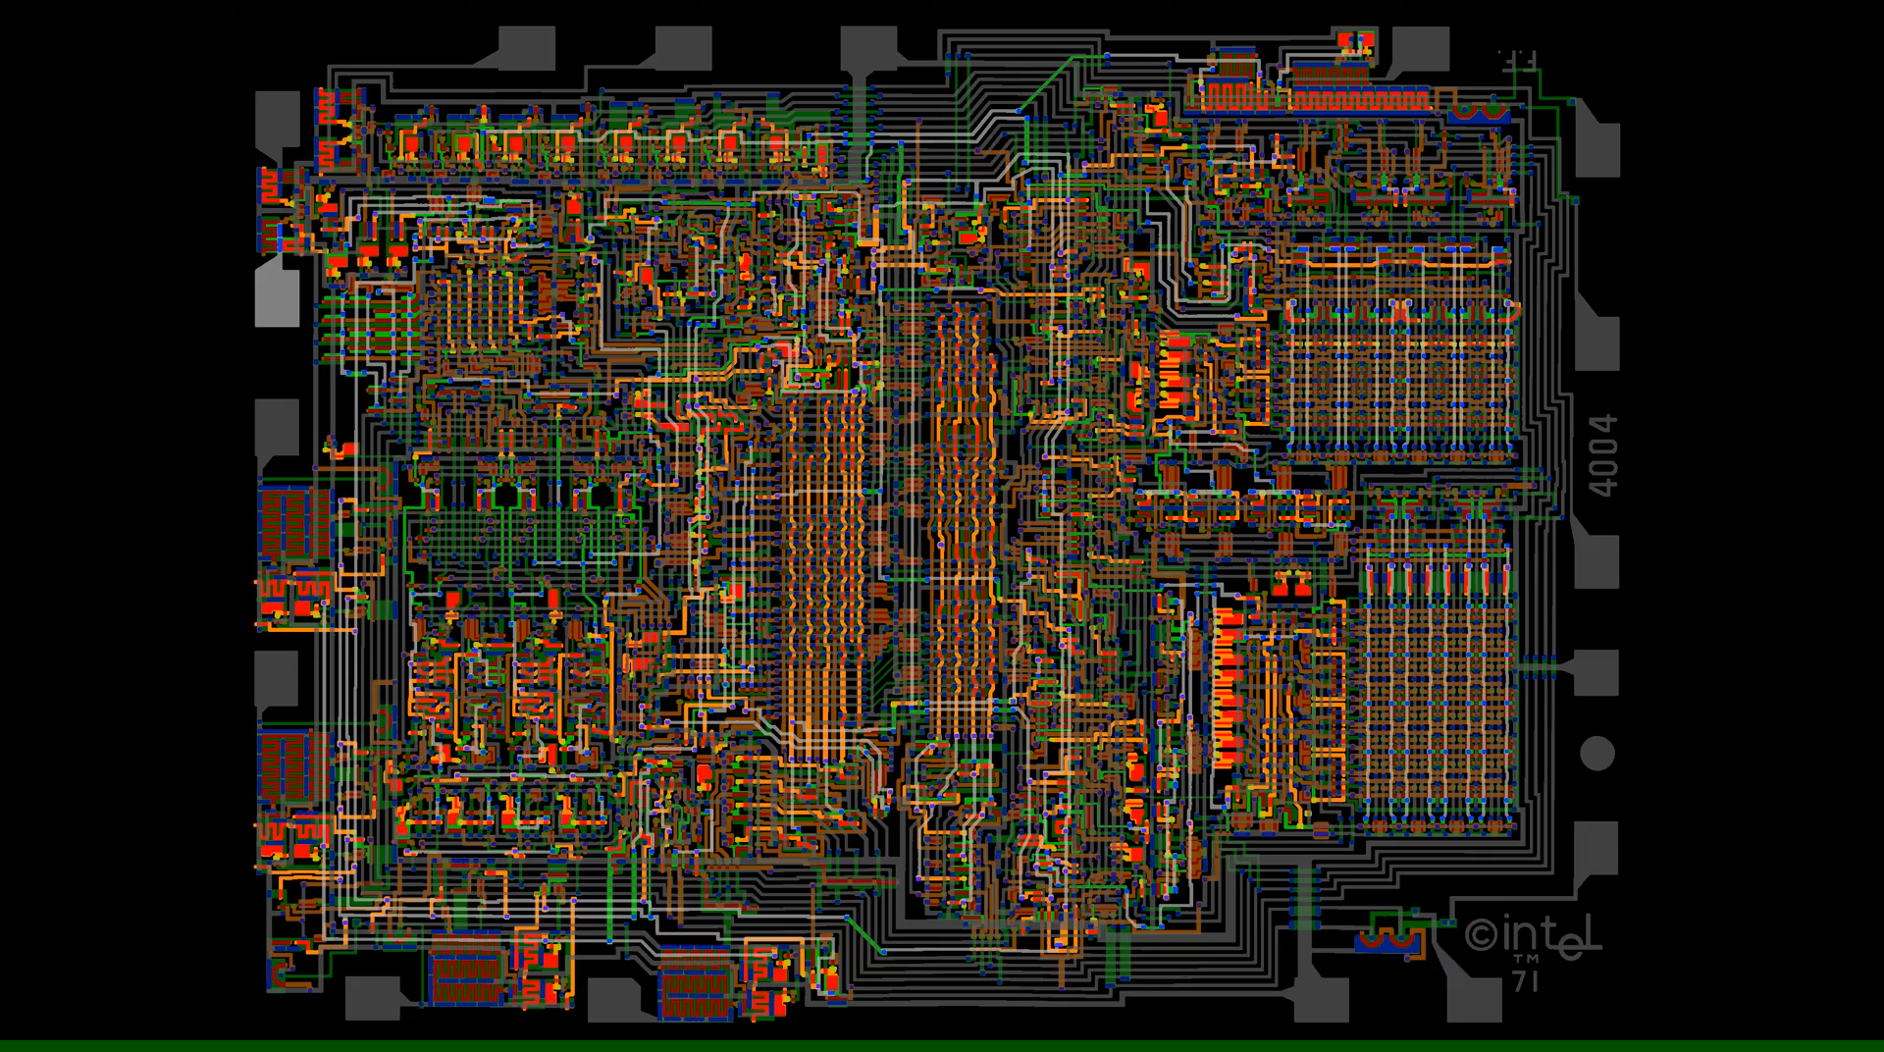
All of NP → Circuit SAT → SAT
Intel 4004 Visual Transistor-level Simulation

Slide 39
All of NP → Circuit SAT → SAT
Let A be a problem in NP.
Given an instance I, a proposed solution S,
there is an algorithm C,
that checks whether S is a solution of I or not
in time polynomial in |I|.
Construct a circuit in polynomial time,
whose known inputs are the bits of I,
whose unknown inputs are the bits of S,
the output is true ⇔ S is really a solution.

Slide 40
All of NP → Circuit SAT → SAT
A graph G with n vertices, an independent set of size k ?
Algorithm C (I, S)
Input: I is the adjacency matrix of a graph G, bits.
S is a 0-1 vector indicating a proposed independent set, n bits.
Output: Whether S is really an independent set or not.
if (the number of 1 in S ≥ k) ∧
(all vertices indicated by S are not adjacent to each other)
return true
else
return false

Slide 41
All of NP → Circuit SAT → SAT
A graph G with n vertices, an independent set of size k ?
n = 3, k = 2
I = (a, b, c) = (1, 1, 0)
Output
Notes:
阿尔法表示所提议的解S中1的个数是否至少为k。每k个一查。
贝塔检查图中任一边，是否两个端点同时被解S选中。

